Slide 1
Good News!!
Bible Study

Slide 2
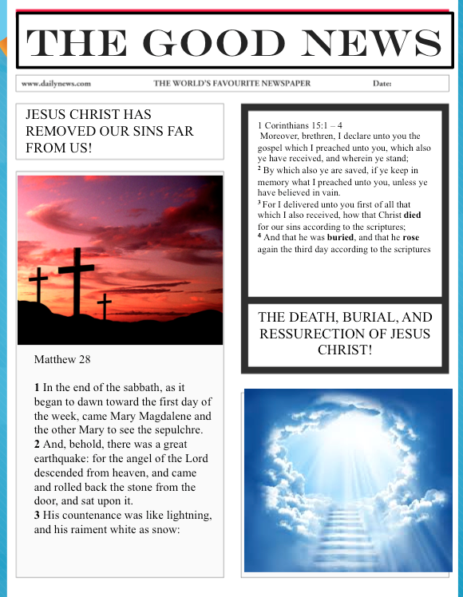

Slide 3
Lesson 1

Slide 4
SECTION 1
WHO IS GOD?

Slide 5

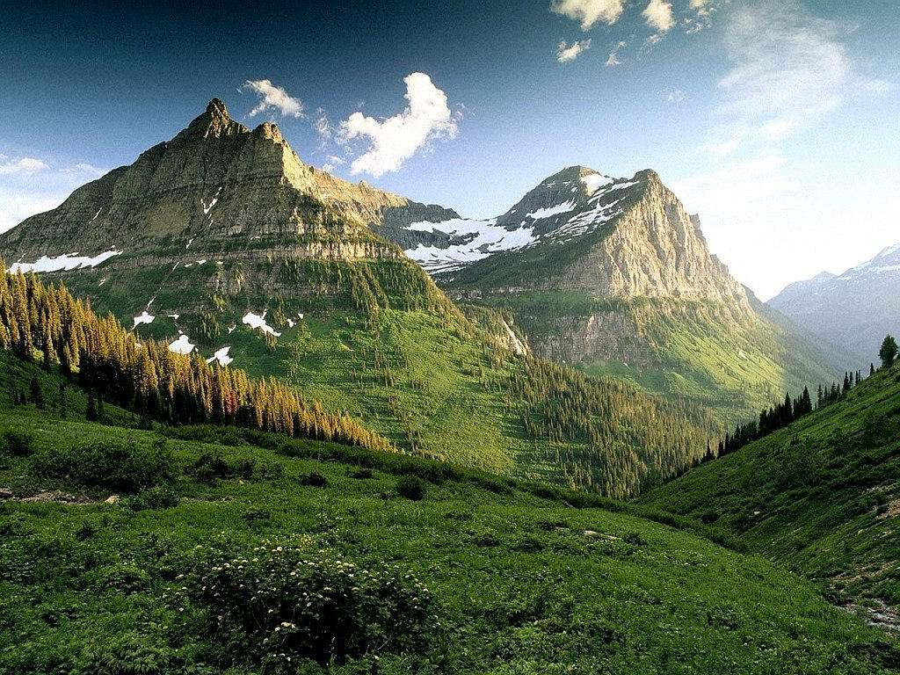
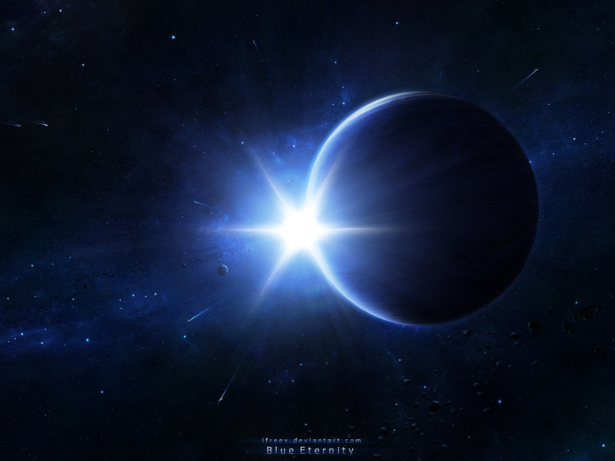
GOD IS ETERNAL!
Psalm 102:23-27 Isaiah 57:15,
Job 36:26, Job 38:4-6, Rev 1:8

Slide 6

(Psalm 5:4-6,
Psalm 18:30)

Slide 7

God is Love!
&
He is a Spirit
(John 4:24, 1st John 4:8)

Slide 8
SECTION 2
CREATION
& HUMANITY’S PURPOSE

Slide 9


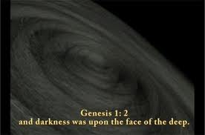

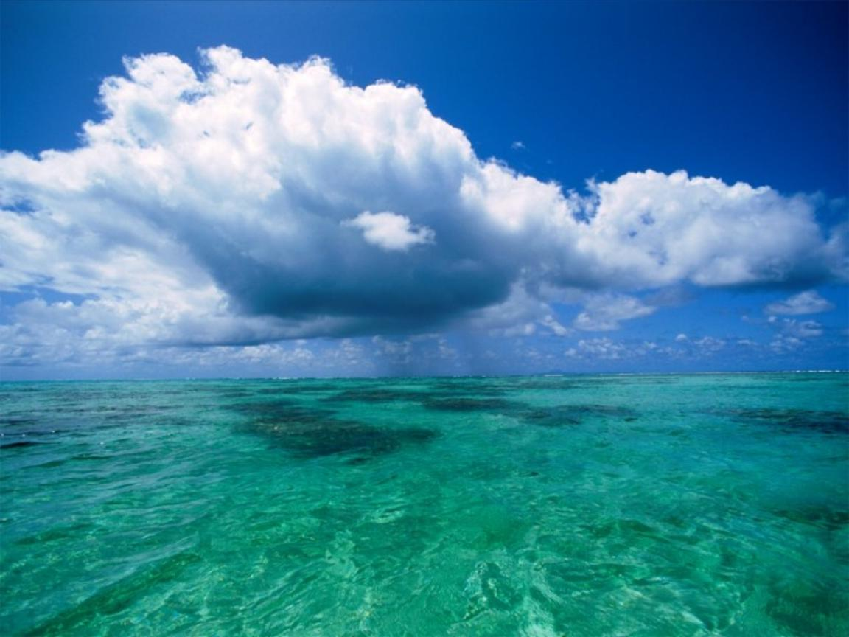

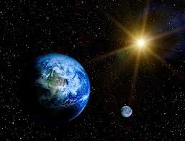
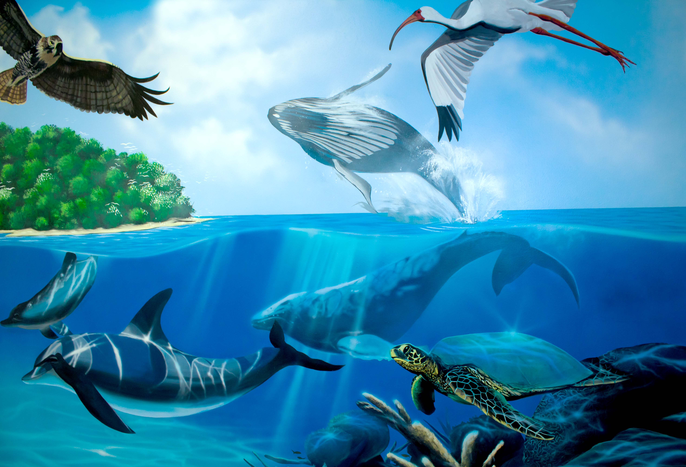
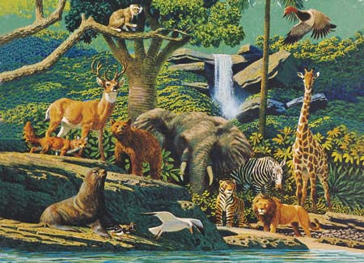
In six days God created light, the sky, earth, waters, grass, trees, fish, birds, animals and insects on land, and man
GENESIS CHAPTER 1
Day 1
“LET THERE BE LIGHT”
Light & Darkness Divided
Day 2
God divided the waters and in between it he called it the sky or (Firmament)
“Let there be firmament in the midst of the waters”
Day 4
Sun, Moon, Stars
Days
Seasons
Years
Day 3
Dry Land—Seas
Grass, Herbs, Trees
Day 6
Animals
& Man
DAY 7
…and he rested on the seventh day…”
Genesis 2:2
Day 5 Fish &
Birds

Slide 10
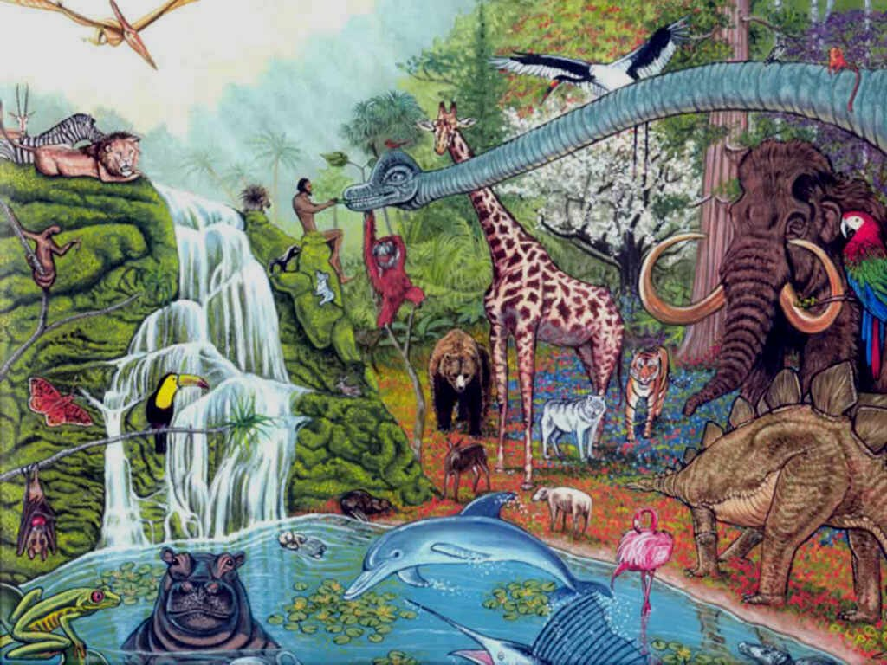



Humanity’s Purpose:
#1 – To rule and have dominion in the earth (Genesis 1:26-28)
#2 – We were created for God’s glory (Isaiah 43:7)
#3 – We were created to serve the Lord with gladness because he is good. (Psalm 100)
#4 - We were created to worship, bow, and kneel before the Lord our maker because he is a great God and the king above all gods. (Psalm 95:3-6)
#5 – We were created to worship no other god but the Lord (Exodus 34:14)
Isaiah 43:7
Even every one that is called by my name: for I have created him for my glory, I have formed him; yea, I have made him.

Slide 11
SECTION 3
GOD’S COMMANDMENT TO MAN IN THE GARDEN OF EDEN

Slide 12
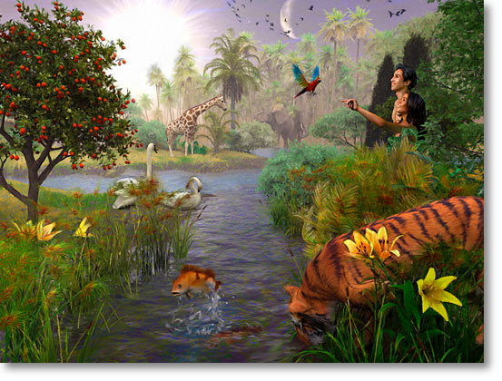
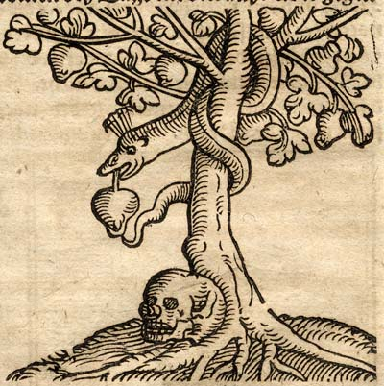
Genesis 2:15 - 17
15 And the Lord God took the man, and put him into the garden of Eden to dress it and to keep it. 16 And the Lord God commanded the man, saying, Of every tree of the garden thou mayest freely eat: 17 but of the tree of the knowledge of good and evil, thou shalt not eat of it: for in the day that thou eatest thereof thou shalt surely die.

Slide 13
SECTION 4
INTRODUCTION TO THE ACCUSER OF OUR SOUL, SATAN.

Slide 14
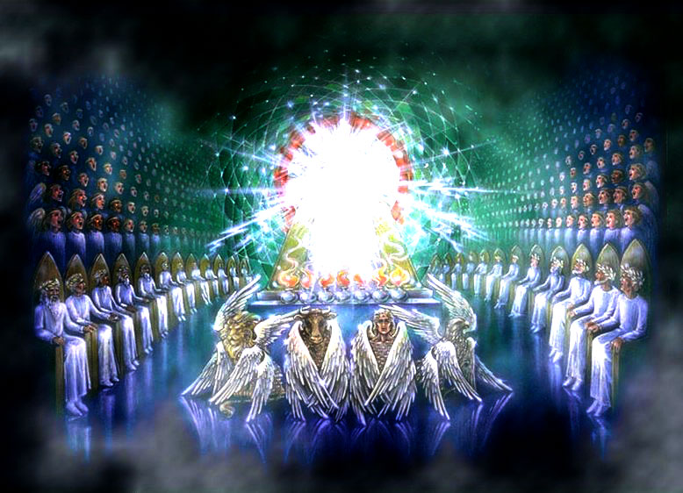
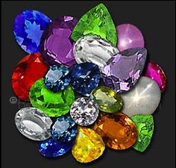

Slide 15
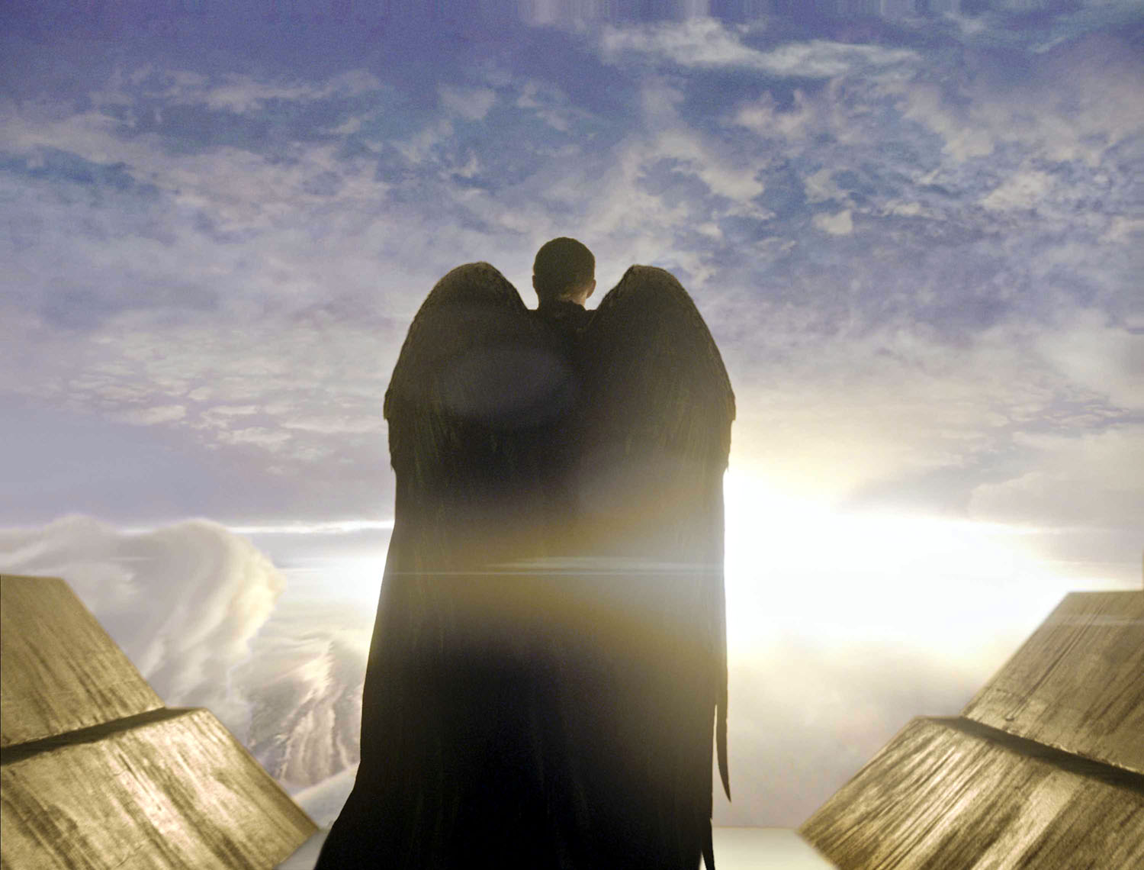
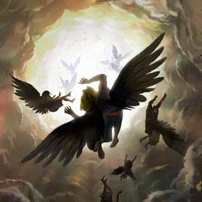
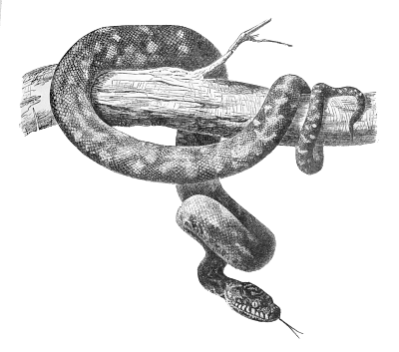
Satan has the ability to transform himself to appear as light: 2 Corinthians 11:14
He and 1/3 of the angels were kicked out of heaven and has gone about to deceive the whole world :
(Revelation 12:9, Revelation12:4)
Genesis 3

Slide 16

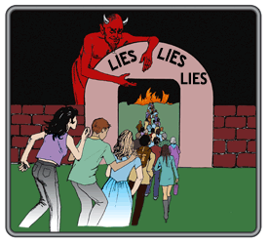
Proverbs 14:12
¹² There is a way which seemeth right unto a man, but the end thereof are the ways of death.
Satan is a liar and the source of all lies:
(John 8:44)
Matthew 7:13-14
13 Enter ye in at the strait (narrow) gate:
for wide is the gate, and broad is the way, that leadeth to destruction, and many there be which go in thereat:
14 Because strait (narrow) is the gate, and narrow is the way, which leadeth unto life, and few there be that find it.

Slide 17
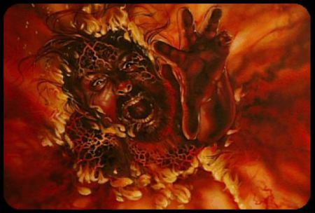
SATAN’S DESTINY
Revelation 20:10
“And the devil that deceived them was cast into the lake of fire and brimstone, where the beast and the false prophet are, and shall be tormented day and night for ever and ever.”

Slide 18
SECTION 5
THE FALL OF THE HUMAN RACE; HUMANITY SEPARATED FROM GOD FOR ETERNITY

Slide 19
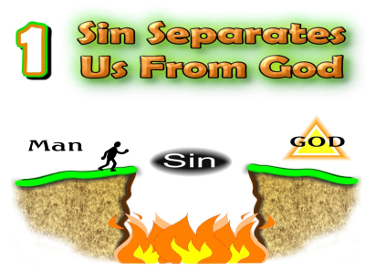
Genesis 2:17
17 but of the tree of the knowledge of good and evil, thou shalt not eat of it: for in the day that thou eatest thereof thou shalt surely die.
Isaiah 59:2
2 but your iniquities have separated between you and your God, and your sins have hid his face from you, that he will not hear.
Romans 6:23 For the wages of sin is death…

Slide 20
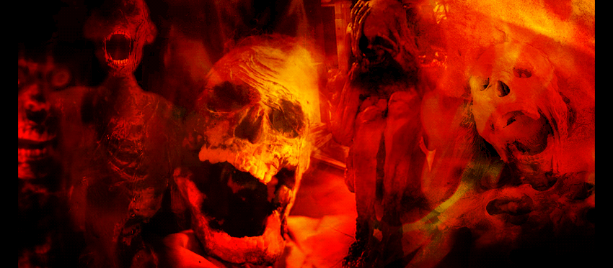
Adam became eternally separated from God and destined to spend eternity in hell, and then eventually the lake of fire. Because he offended holy God.
(Romans 5:12)

Slide 21
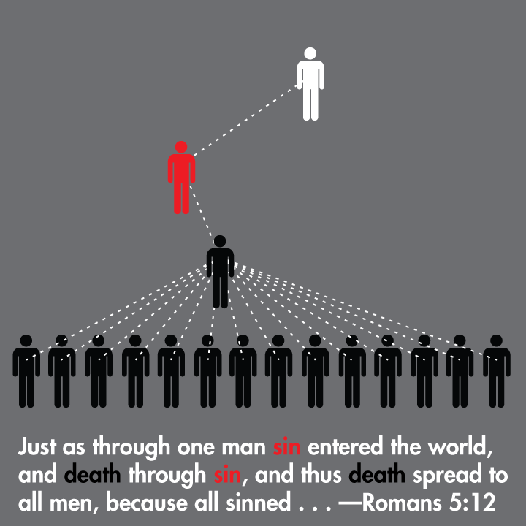
Adam’s destiny became
Our destiny.

Slide 22
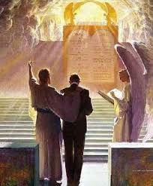
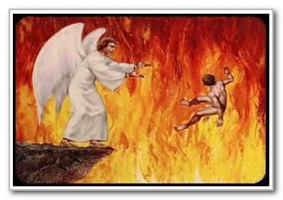
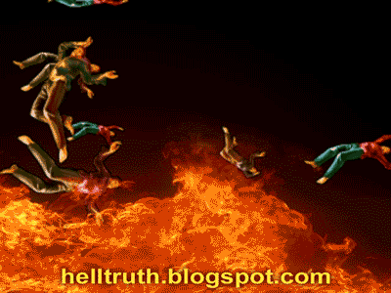
Our future because of sin
Revelation 20:11-15 “And I saw a great white throne, and him that sat on it, from whose face the earth and the heaven fled away; and there was found no place for them.
12 And I saw the dead, small and great, stand before God; and the books were opened: and another book was opened, which is the book of life: and the dead were judged out of those things which were written in the books, according to their works.
13 And the sea gave up the dead which were in it; and death and hell delivered up the dead which were in them: and they were judged every man according to their works.
14 And death and hell were cast into the lake of fire. This is the second death.
15 And whosoever was not found written in the book of life was cast into the lake of fire”

Slide 23
Review (from Lesson 1)
Who is God?
  He is love, holy, pure, and eternal
2. What is humanity’s purpose?
  To bring God glory
3. What was God’s commandment to man?
  To not eat from of the tree of the knowledge of good and evil. When you eat of it you will surely die.
4. Who is the main enemy of our soul?
  Satan
5. How and why did the human race fall?
  Because Adam and Eve disobeyed God because they listened to the serpent.

Slide 24
Lesson 2

Slide 25
SECTION 6
GOD’S PLAN TO REDEEM HUMANITY FROM SIN AND DEATH

Slide 26

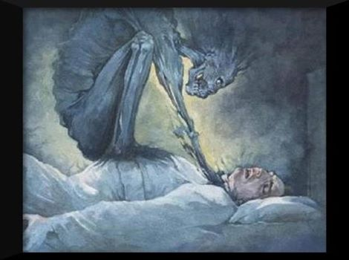
Romans 5:14 “Nevertheless death reigned”
Romans 5:21
“that as sin hath reigned unto death….”
Sin and death were champion over all humans who would be born since Adams fall, Satan had the keys to death and hell over humanity
(Psalm 51:5)(Isaiah 5:14)

Slide 27
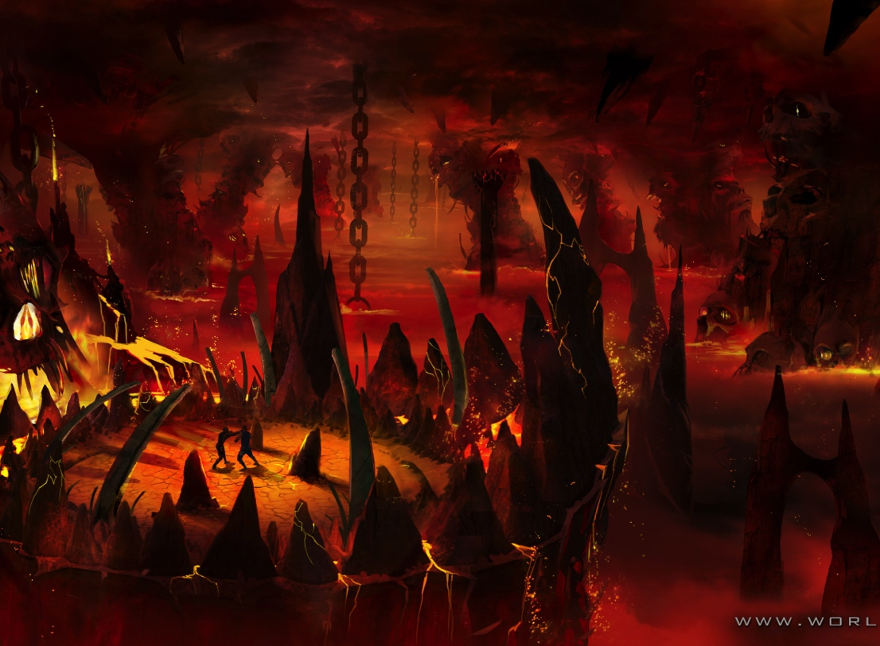
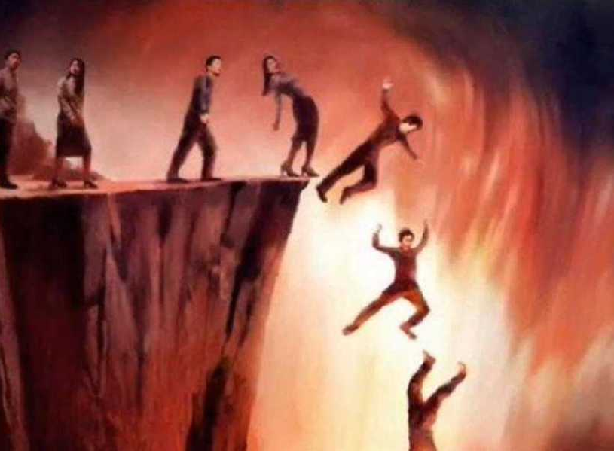
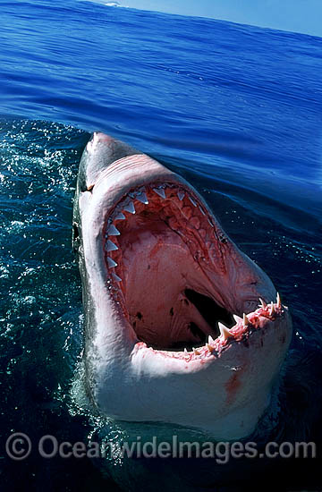
(Psalm 51:5))
We are all under an eternal death sentence
because of sin!
Isaiah 5:14
Therefore hell hath enlarged herself, and opened her mouth without measure: and their glory, and their multitude, and their pomp, and he that rejoiceth, shall descend into it.

Slide 28
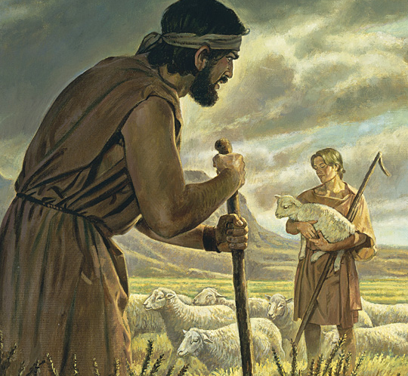
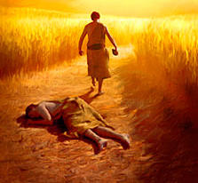
Sin produces death of all kinds:
(Genesis 4:1-8)
Sin produces jealousy.
Sin produces murder.

Slide 29
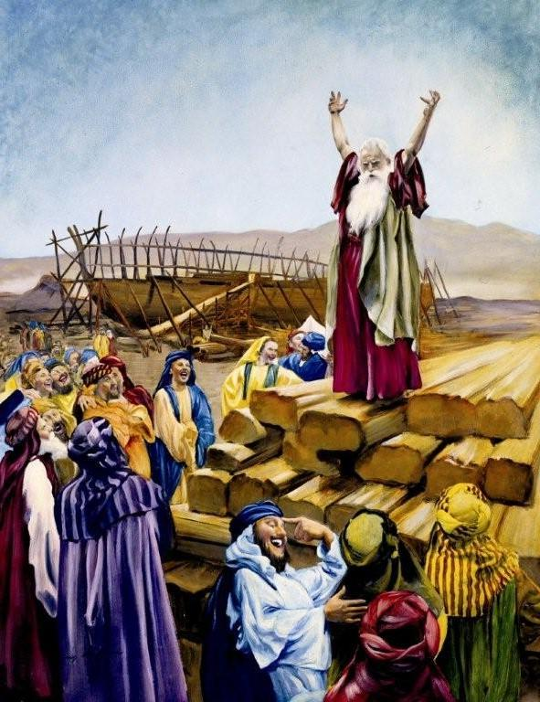
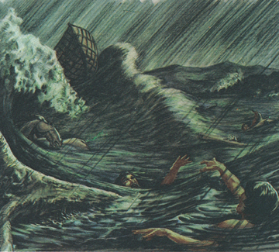
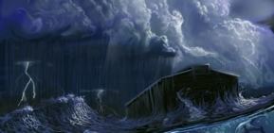
NOAH & THE FLOOD
(Genesis 6:5-8, 2 Peter 2:5,)
1 Peter 3:20
when once the longsuffering of God waited in the days of Noah…
Genesis 6
2 Peter 2:5 And spared not the old world, but saved Noah the eighth person, a preacher of righteousness, bringing in the flood upon the world of the ungodly

Slide 30
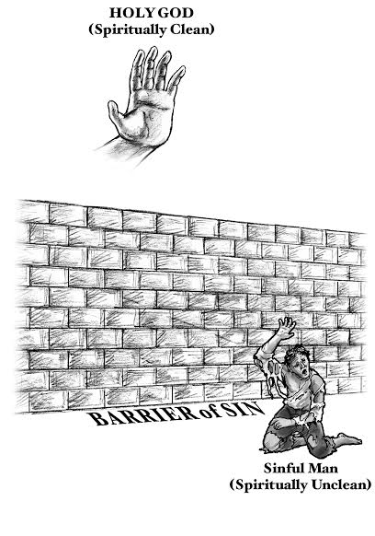
God was angry at the sins that separated us from him! Our sins came between us and God!
Isaiah 59:2
but your iniquities have separated between you and your God, and your sins have hid his face from you, that he will not hear.

Slide 31

God hates sin because it separated us from him for an eternity.

Slide 32
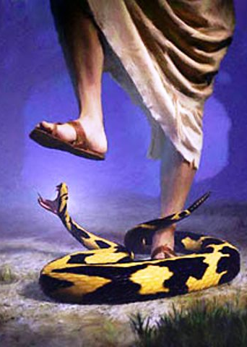
God’s punishment to the serpent / Satan / the deceiver in the garden of Eden.
"And I will put enmity between thee and the woman, and between thy seed and her seed; it shall bruise thy head, and thou shalt bruise his heel.” – Genesis 3:15
The woman and seed that God was talking about was The virgin Mary and Jesus Christ! God spoke this thousands of years before Jesus came.

Slide 33
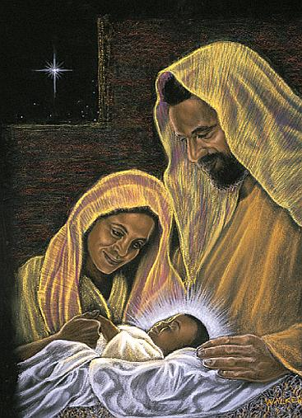
That Messiah comes to earth! JESUS!

Slide 34
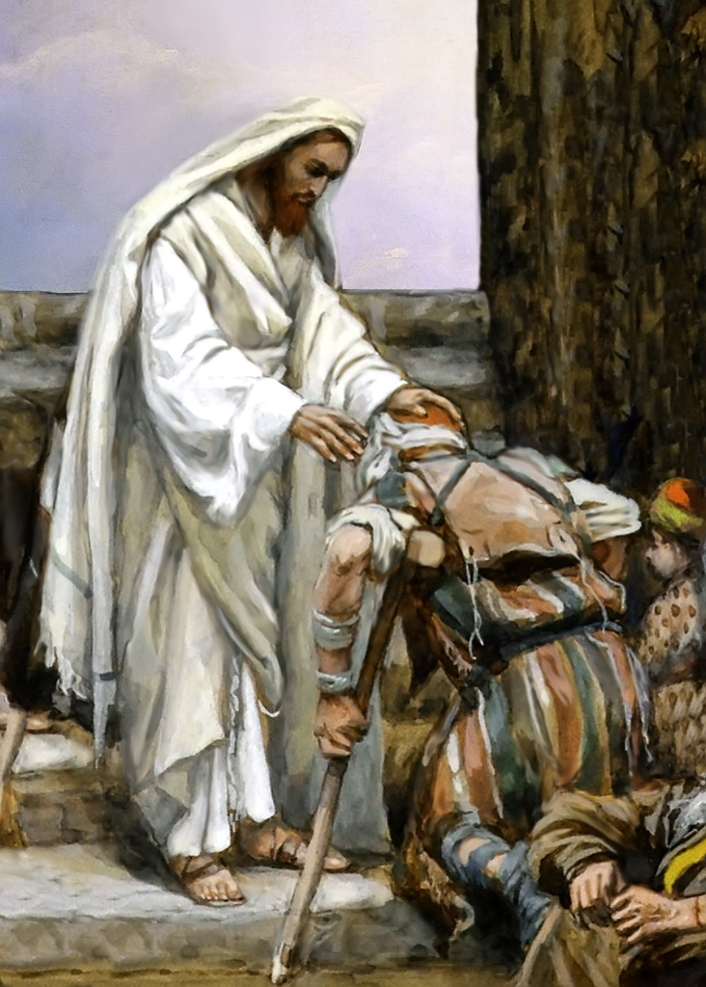
Jesus healed the sick (Mark 1:34)
Raised the dead (John 11)
Open blind eyes (Mark 10:46-52)
Cast out devils (Matthew 8:31)
Calmed the weather by speaking to it (Mark 4:39)
Many other miracles (John 21:25)
Jesus the Anointed one was/is
100% God and 100% man.
Isaiah 9:6
“For unto us a child is born, unto us a son is given: and the government shall be upon his shoulder: and his name shall be called Wonderful, Counsellor, The
mighty God, The everlasting Father, The Prince of Peace.”
Almighty God in the flesh!

Slide 35
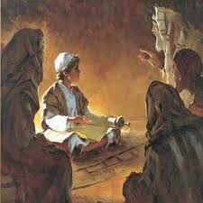
The Humanity of Jesus
He had a human will just like you and I. (Hebrews 4:15)
He knew even since a child what his purpose was and that was to eventually bare the sins of the entire world.
At 12 years old Jesus said “I must be about my Father’s business.” Luke 2:49
The Father’s business was to ultimately make Jesus an offering for (our) the world’s sin!
God would redirect his anger and punishment that he had towards our sin which we deserved and place it all on Jesus. All because we could not handle God’s wrath.

Slide 36
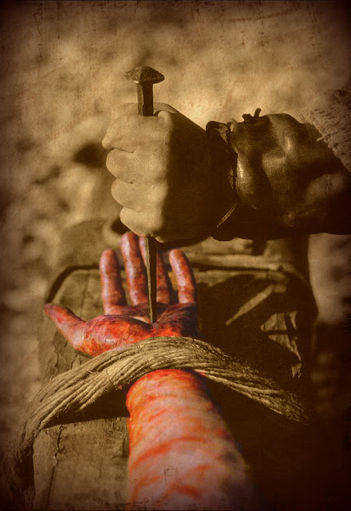
John 10:17-18
17 Therefore doth my Father love me, because I lay down my life, that I might take it again.
18 No man taketh it from me, but I lay it down of myself. I have power to lay it down, and I have power to take it again. This commandment have I received of my Father.
Isaiah 53:10-12
10 Yet it pleased the Lord to bruise him; he hath put him to grief: when thou shalt make his soul an offering for sin, he shall see his seed, he shall prolong his days, and the pleasure of the Lord shall prosper in his hand.
11 He shall see of the travail of his soul, and shall be satisfied: by his knowledge shall my righteous servant justify many; for he shall bear their iniquities.
12 Therefore will I divide him a portion with the great, and he shall divide the spoil with the strong; because he hath poured out his soul unto death: and he was numbered with the transgressors; and he bare the sin of many, and made intercession for the transgressors.

Slide 37
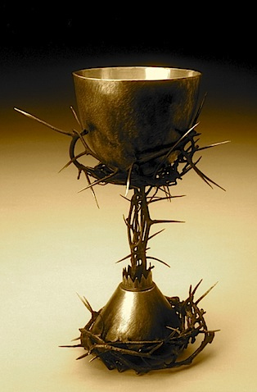
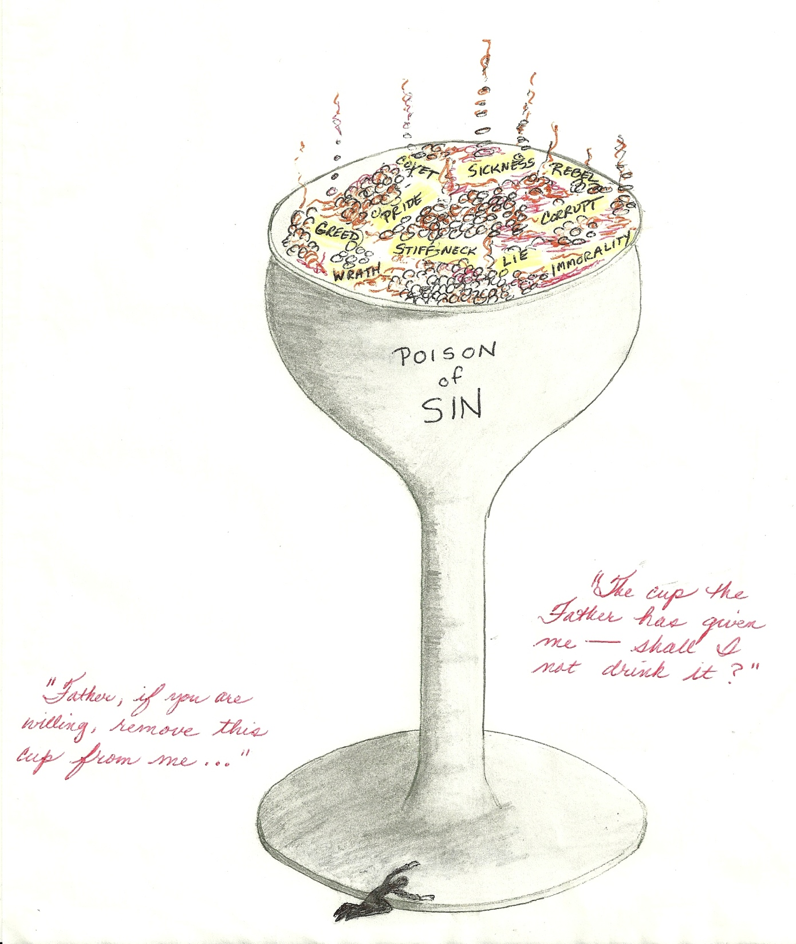
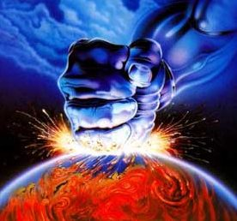
The cup of sin!
The cup Jesus drank was the entire world’s sin!
Luke 22:42
saying, Father, if thou be willing, remove this cup from me: nevertheless not my will, but thine, be done. (Psalm 75:8)
Jesus prayed until he sweat blood Luke 22:44
Gods wrath came down on sin
“Passion for your house has consumed me, and the insults of those who insult you have fallen on me” – Psalm 69:9 (NLT)

Slide 38
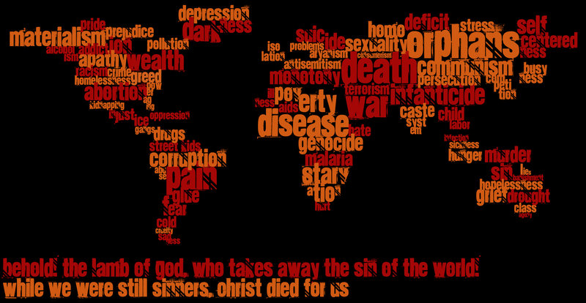

Hebrews 9:15
The curse of every sin of the world was upon Jesus.
(Isaiah 53:4-6, 2 Corinthians 5:21)
1 Peter 2:24 who his own self bare (carried) our sins in his own body on the tree, that we, being dead to sins, should live unto righteousness: by whose stripes ye were healed.

Slide 39

Romans 8:3
“God sending his own Son in the likeness of sinful flesh, and for sin, condemned sin in the flesh:”
(John 19:30, Romans 5:15, Romans 5:17,Romans 6:23)
“He tasted death for every man.”
Hebrews 2:9

Slide 40
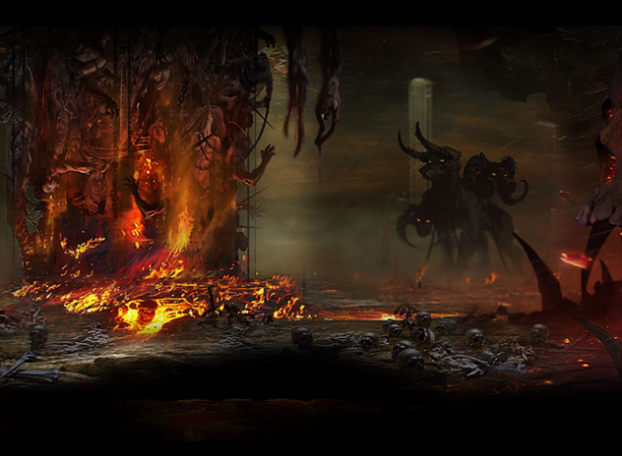
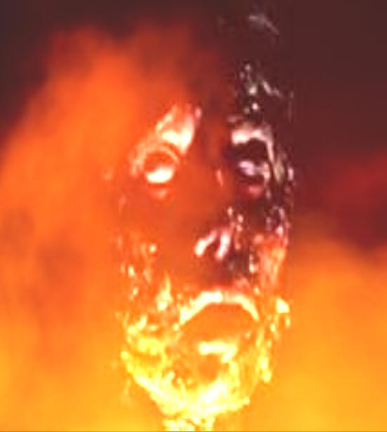
Jesus went to where sin and death brings us….hell.

Slide 41
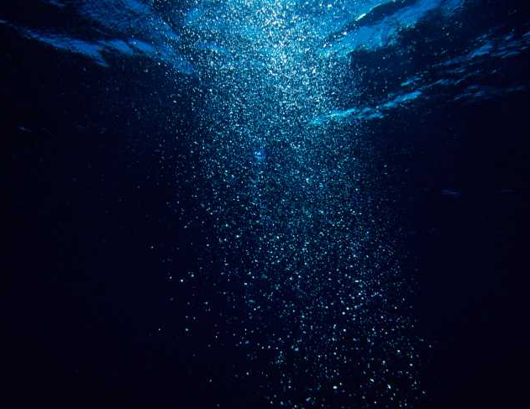
Micah 7:19
¹⁹ He will turn again, he will have compassion upon us; he will subdue our iniquities; and thou wilt cast all their sins into the depths of the sea.

Slide 42
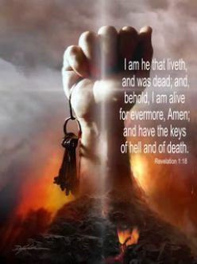
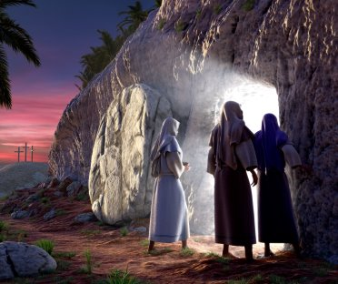

1 Peter 3:18-20 For Christ also hath once suffered for sins, the just for the unjust, that he might bring us to God, being put to death in the flesh, but quickened by the Spirit:
19 By which also he went and preached unto the spirits in prison;
Matthew 28:1-10
Hebrews 2:14-15
14; that through death he might destroy him that had the power of death, that is, the devil; 15 And deliver them who through fear of death were all their lifetime subject to bondage.

Slide 43

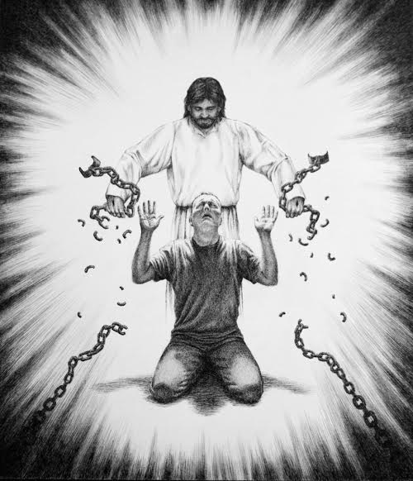
Now Jesus has the power of life and the power over death and hell!
Matthew 28:18
”And Jesus came and spake unto them, saying,
All power is given unto me in heaven and in earth.”

Slide 44
Mark 16:15
And he said unto them, Go ye into all the world, and preach the gospel to every creature.
Jesus commanded his disciples to go and tell this good news to everyone!
John 10:10
The thief cometh not, but for to steal, and to kill, and to destroy: I am come that they might have life, and that they might have it more abundantly.
John 14:6
Jesus saith unto him, I am the way, the truth, and the life: no man cometh unto the Father, but by me.

Slide 45

QUIT YOUR SINS!
Mark 1:14-15
“ ..preaching the gospel of the kingdom of God,
15 And saying, The time is fulfilled, and the kingdom of God is at hand: repent ye, and believe the gospel.”
Mark 16:16
“He that believeth and is baptized shall be saved; but he that believeth not shall be damned.”
Acts 2:38
(Matthew 16:24)

Slide 46
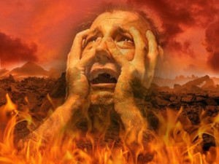



Revelation 21:1-8
John 8:24 ”I said therefore unto you, that ye shall die in your sins: for if ye believe not that I am he, ye shall die in your sins.”
John 5:28-29 “Marvel not at this: for the hour is coming, in the which all that are in the graves shall hear his voice, And shall come forth; they that have done good, unto the resurrection of life; and they that have done evil, unto the resurrection of damnation”

